Slide 1
Housing project
Name – Kaushik veer

Slide 2
Contents
Introduction
Analytical Problem Framing
EDA and Visualization
Model building and evaluation
Results
Conclusion

Slide 3
Introduction
Houses are one of the necessary need of each and every person around the globe and therefore housing and real estate market is one of the markets which is one of the major contributors in the world’s economy. It is a very large market and there are various companies working in the domain. Data science comes as a very important tool to solve problems in the domain to help the companies increase their overall revenue, profits, improving their marketing strategies and focusing on changing trends in house sales and purchases. Predictive modelling, Market mix modelling, recommendation systems are some of the machine learning techniques used for achieving the business goals for housing companies. Our problem is related to one such housing company.
A US-based housing company named Surprise Housing has decided to enter the Australian market. The company uses data analytics to purchase houses at a price below their actual values and flip them at a higher price. For the same purpose, the company has collected a data set from the sale of houses in Australia.

Slide 4
Analytical Problem Framing
The company is looking at prospective properties to buy houses to enter the market. You are required to build a model using Machine Learning in order to predict the actual value of the prospective properties and decide whether to invest in them or not. For this company wants to know:
• Which variables are important to predict the price of variable?
• How do these variables describe the price of the house?
Data contains 1460 entries and 81 variables.
We need to predict the house prices for the dataset after analysing the data and help Surprise Housing company with some good insights in valuable areas.
We will be checking the relation of variables with the house pricing .
We will find the important features which affects price positively and negatively.

Slide 5
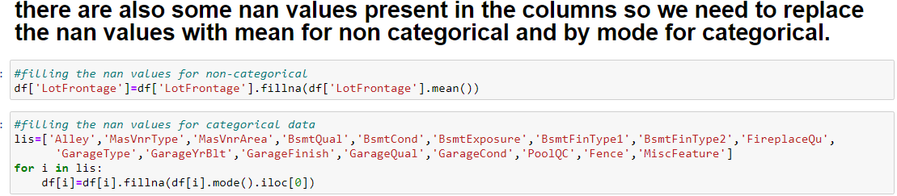
EDA and visualization
Data contains object type data as well as float and integer type data. We need to convert the object type data into numerical before model building.
Data contains some nan values which we will fill the data with mean for non categorical data and by mode(most frequently occurring element) for categorical data.
We dropped the ID column as it was only gives the identity to the particular entry and is unique for every entry which won’t help us in model building or prediction of data.

Slide 6
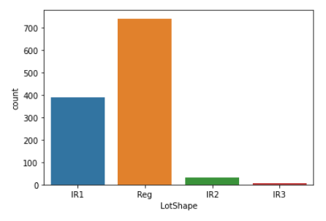
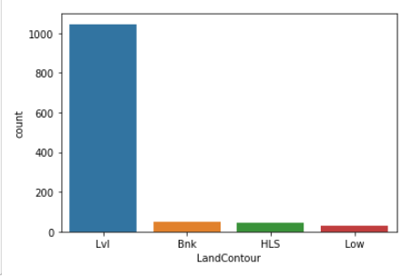
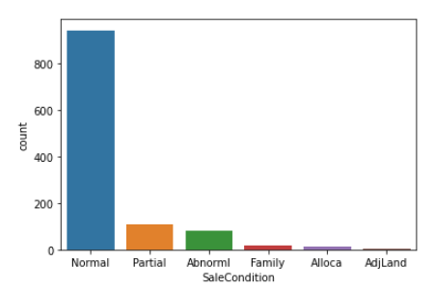
From the above count plots of object type data what we can observe is :-
In lotshape the highest number of counts are Reg followed by IR1
In land contour lvl has the highest majority and rest all other similar to each other.
In sale condition normal sale have the highest number of counts followed by partial. Sales condition is strong with normal people.

Slide 7
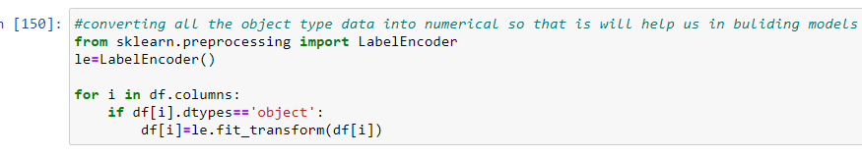
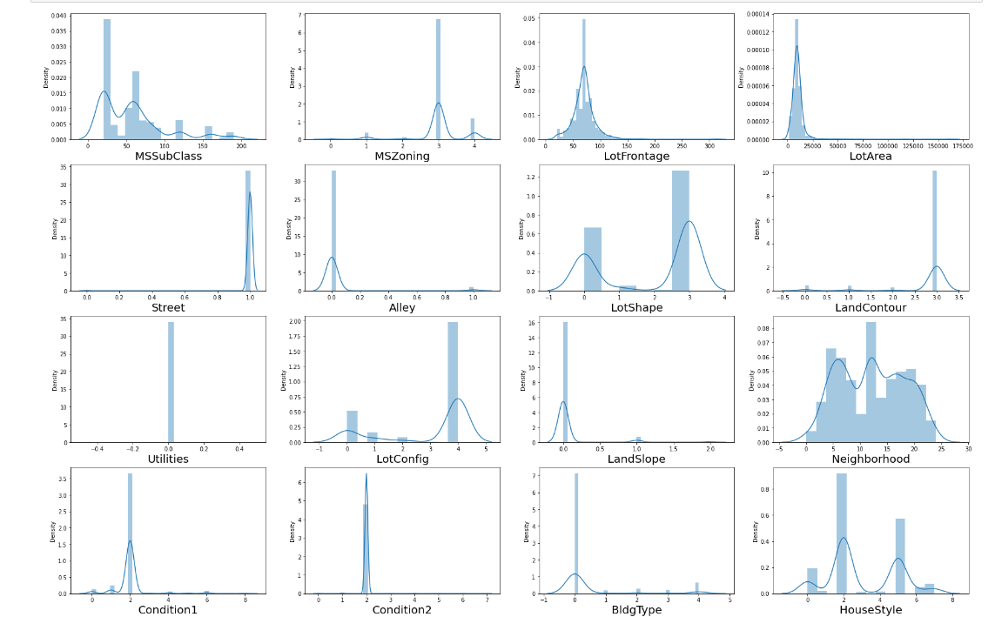
We used label encoder to convert object type data into numerical.
after encoding it will help us in getting better understanding of the data and build prediction models.
Above are the distribution plots to observe the normal distribution in the data.

Slide 8
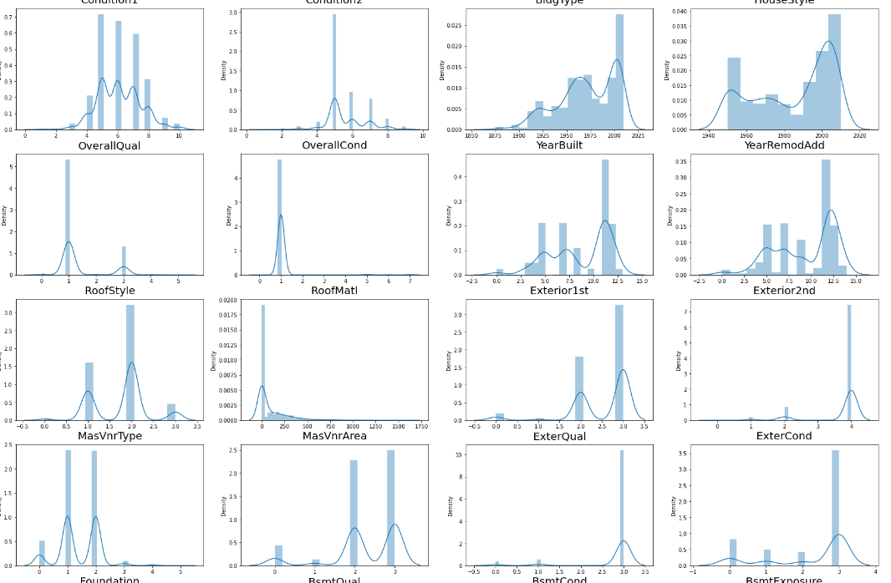
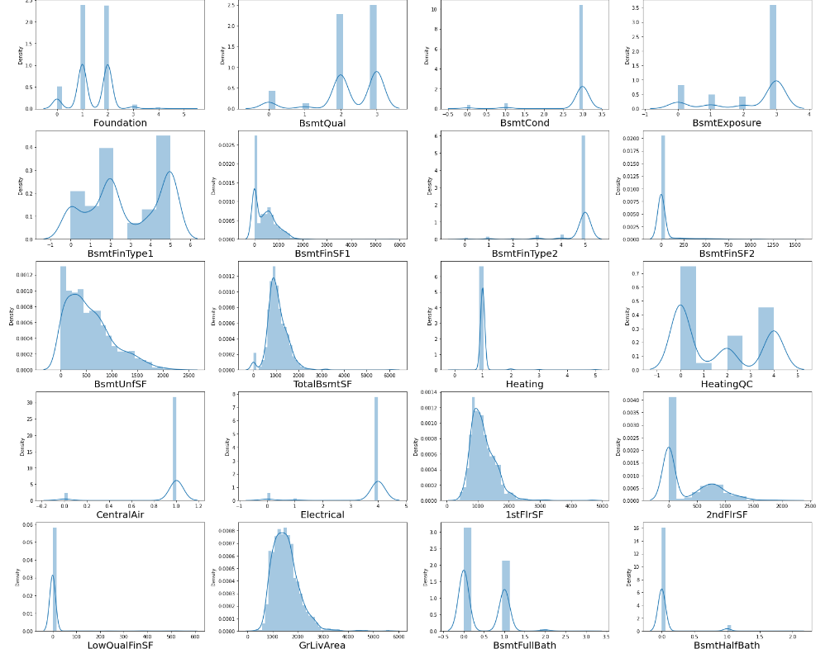
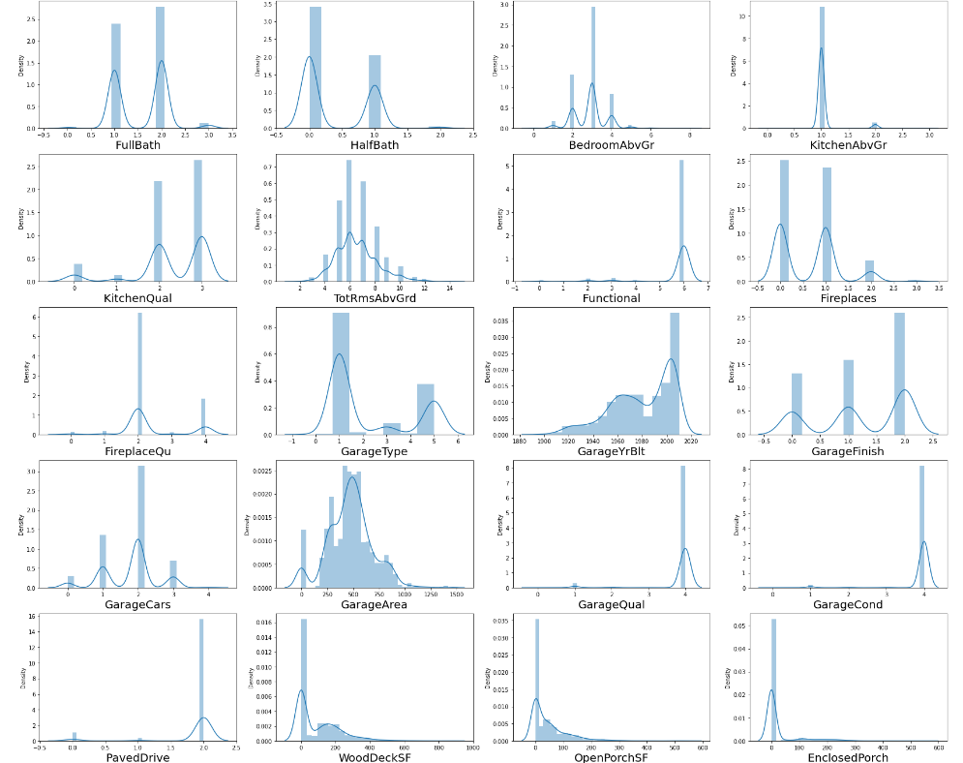

Slide 9
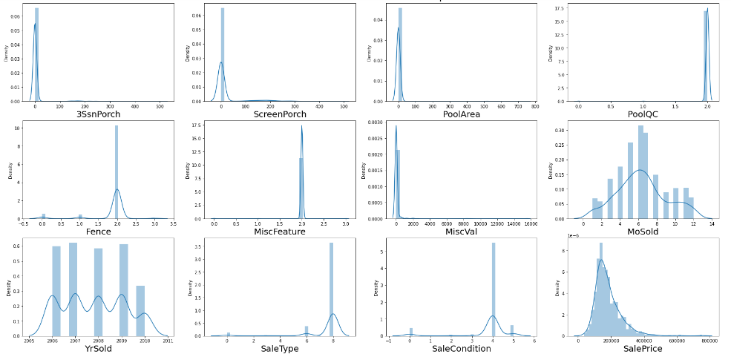
Observations:
Columns having normal distribution are :-
LotFrontage, Alley, LandContour, Condition1, Conditional2, BldgType, RoofMatl, MasVnrArea, BsmtCond, BsmtFinType2, BsmtFinSF2, LotArea, BsmtUnfSF, TotalBsmtSF, Heating, CentralAir, Electrical, 1stFlrSF, LowQualFinSF, GrLivArea, KitchenAbvGr, Functional,
GarageYrBlt, Street, GarageQual, GarageCond, PavedDrive, OpenPorchSF, EnclosedPorch, 3SsnPorch, ScreenPorch, PoolArea, PoolQC, Fence, MiscFeature, MiscVal, SaleType, SalePrice.
Rest all have bimodal type distribution plot.

Slide 10
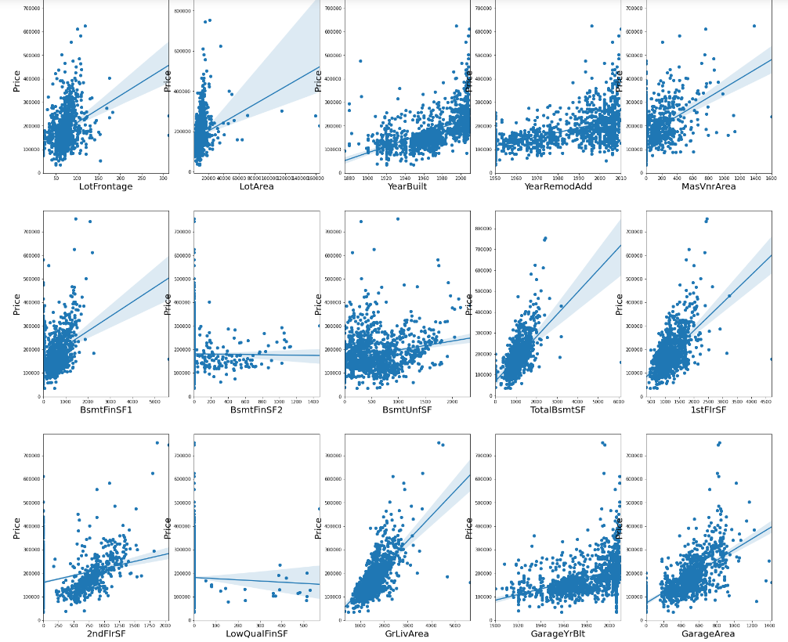
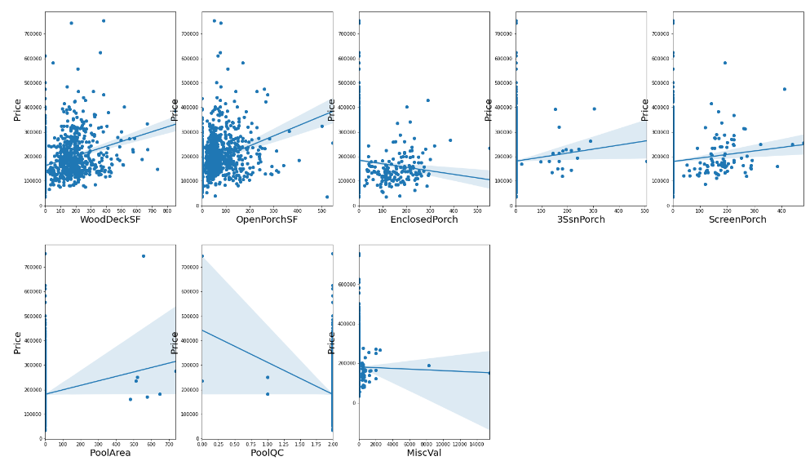
Checking scatter and reg plots for checking relation of variables with the price.

Slide 11
Observation of scatter and reg plots :-
Column OpenporchSF, WoodDeckSF, GarageArea, GarageYrBuilt, GrlivArea, 1stflrsf, 2ndflrsf, totalbsmtsf, YearremodAdd, Yearbuilt , lotfrontage,lotarea, masvnrarea, bsmntfinsf1 have positive correlation with column salesprice as we can see in the graphs above
column MiscVal, Enclosedporch have some negative correlation with sale price.
remaining columns dont have correlation with salesprice.
This gives us the insights of our problem of finding most positive and negative correlated variables with the price.

Slide 12
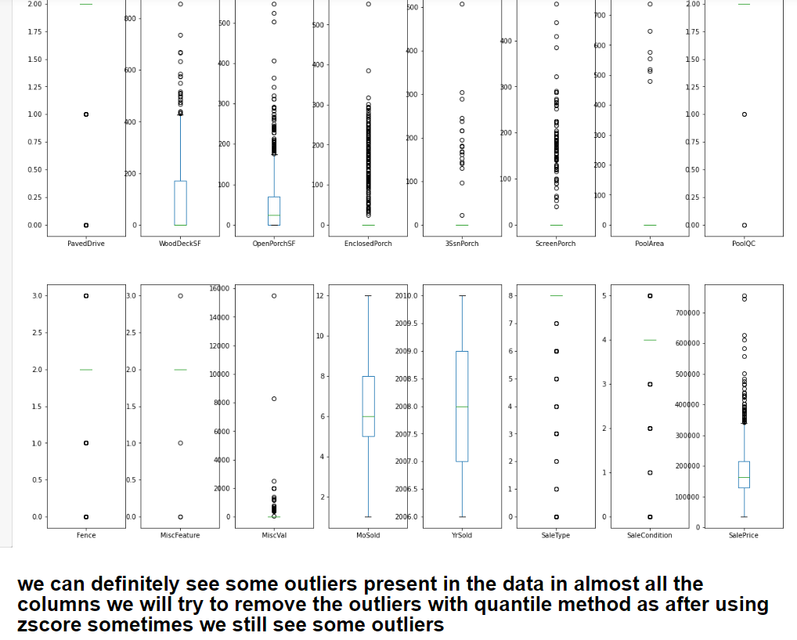
Checking and removing outliers so that we can predict good results
we saw that there are some outliers present in
almost every column so we removed the outlier
using quantile method.

Slide 13
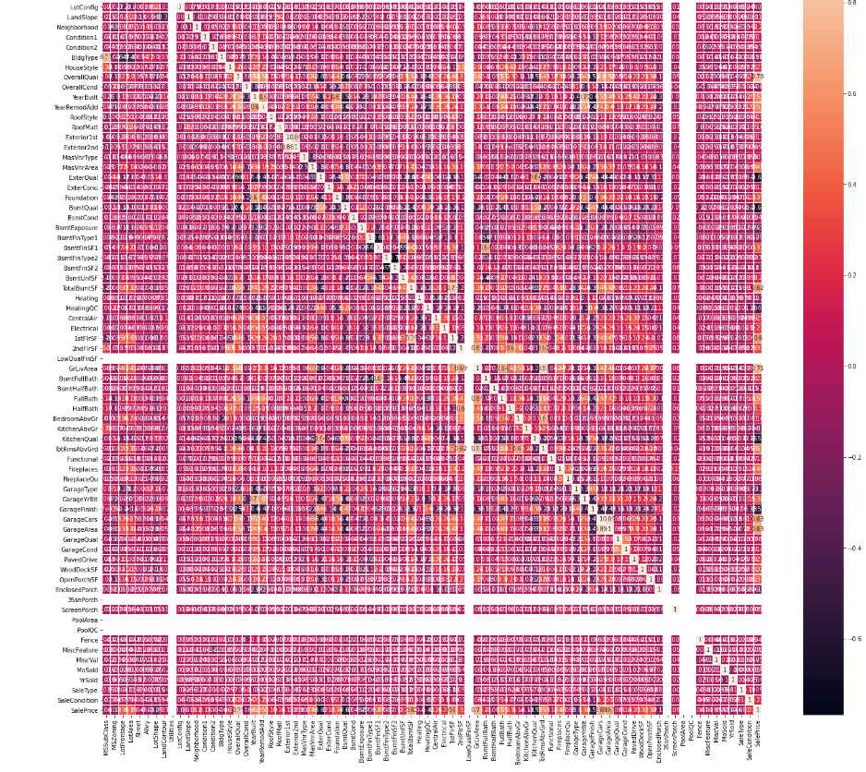
Checking correlation
After checking the correlation there is not much insight as very less columns are strongly correlated with the output variable which is Salesprice of the houses in the Australian region.

Slide 14
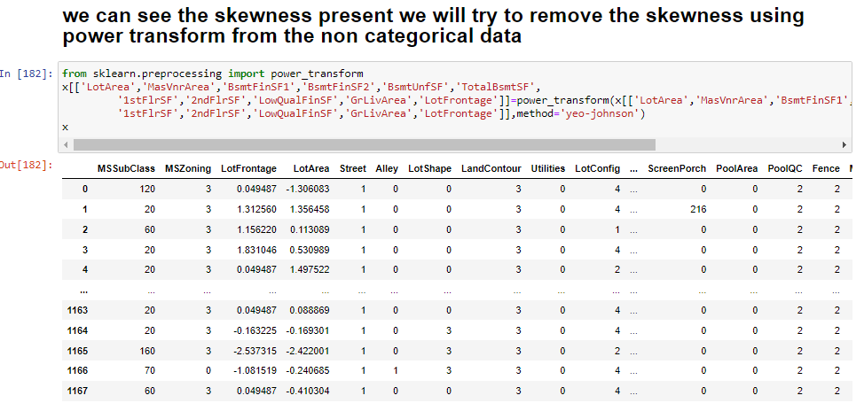
Removing skewness
We saw that there is skewness present in the non categorical variables like :-
LotArea, MasVnrArea, BsmtFinSF1 ,BsmtFinSF2, BsmtUnfSF, TotalBsmtSF, 1stFlrSF, 2ndFlrSF, LowQualFinSF, GrLivArea, LotFrontage.
We used power transform method to remove skewness from the data.

Slide 15
Model building and evaluation
We split the data into X & Y where x holds all the input variables and y holds the output variable.
We used standard scaler to scale the data and we went forward with model building of the data.
we will check the metrics such as r2_score and mean cross val score as well as mean absolute erroe before choosing the best model
We used regression models to predict the data like GradientBoostingRegressor, LinearRegression, Ridge, BayesianRidge, SGDRegressor, SVR, AdaBoostRegressor, KNeighborsRegressor, RandomForestRegressor, BaggingRegressor, DecisionTreeRegressor ,ExtraTreesRegressor.
Below are the images of the results that we got from our models and their r2 score, cross val mean score, as well as the error.

Slide 16
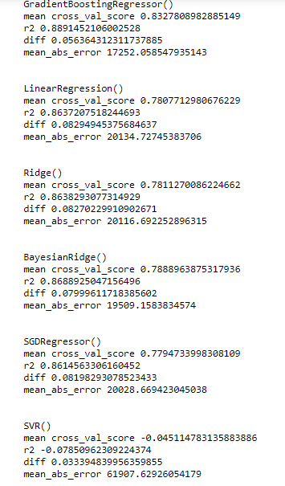
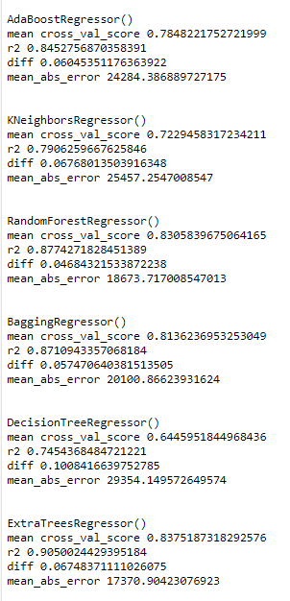

Slide 17
Observations
Our best performing model is ExtratreeRegressor with 90% accuracy.
After extra tree our 2nd and 3rd best models are random forest regressor with close to 88% r2 score and gradient boosting with close to 89% r2 score.
We will try to hyper tune our top 3 models and check whether we can improve the accuracy.
Above are the images of the results that we got from hyper tuning the top 3 models.

Slide 18
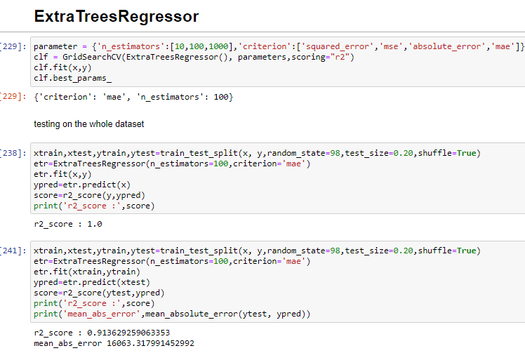
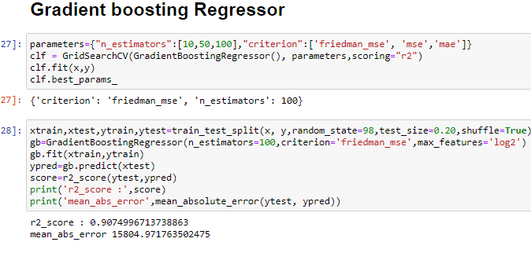
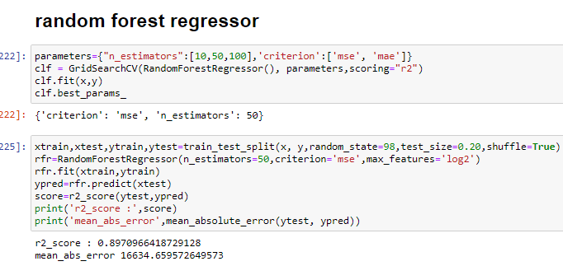

Slide 19
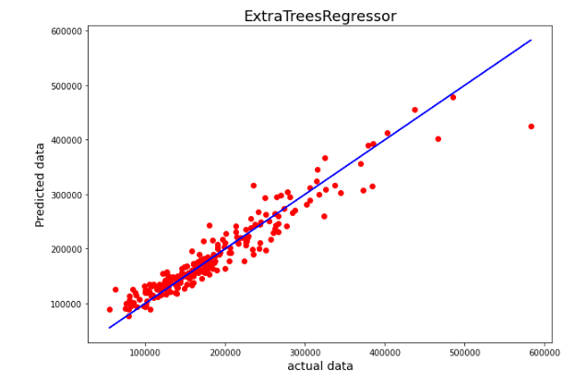
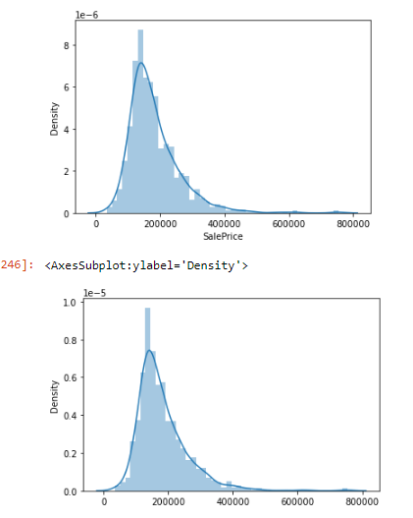
results
After hyper tuning we got close to 90% accuracy and with less error with random forest regressor.
after hypertuning on Gradient boosting we got the accuracy of 90%.
we found our best performing model with 91% accuracy which is ExtraTreeRegressor.
From the above images we can see that the actual data and the predicted data by our model very close to each other.

Slide 20
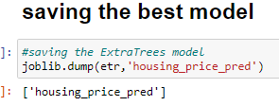
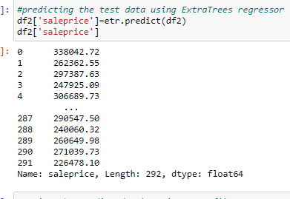
We saved the best performing model which is Extra Trees Regressor and used the model to predict the prices from the test data that we were provided.
There were some presence of nan values, skewness and outliers after doing the cleansing of data we performed prediction on the test data with our model and above are the results.
We have saved the predicted results in a csv file.

Slide 21
conclusion
We were suppose to clean and analyse the data and predict house prices for the surprise housing company.
We did some analysing cleansing of the data were able to perform some valuable analysis and we got the insights of features that we were affecting the price positively and negatively.
We were able to build a very good model with the accuracy of 91% which is quaite good.
We saw in the graphs that the actual data and the predicted data provided by our model were very close to each other.
We predicted the results for the test data using our best perfoming model.
We can say that with more accurate data we can still improve the model with valuable features.

